Slide 1
Week 11 Cloud Security
Dr Zhi Zhang

Slide 2
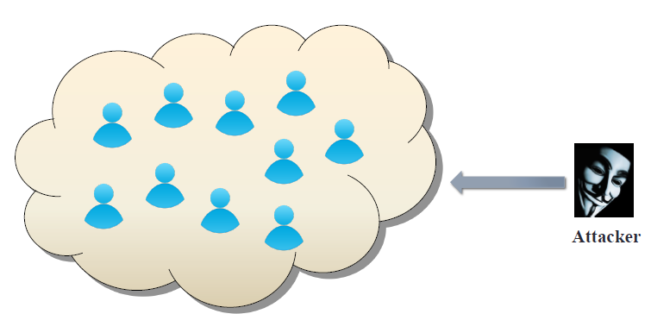
Public cloud becomes tempting target
Valuable targets:
banking, medical information, DNN models

Slide 3
Overview
Introduction to key terms in public cloud security
Co-residence attacks and mitigations
Cross-VM attacks and mitigations

Slide 4
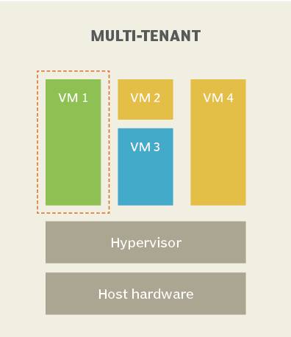
Key Terms
Multi-tenancy:
IaaS clouds multiplex virtual machines (VMs) of disjoint customers upon the same physical machines.
Co-residency:
A malicious VM is co-resident with a target VM upon the same physical machine.
https://www.techtarget.com/whatis/definition/multi-tenancy

Slide 5
Key Terms
Multi-tenancy:
Co-residency:
Placement:
The adversary manages to place their malicious VM onto the same physical machine as their target VM.

Slide 6
Key Terms
Multi-tenancy:
Co-residency:
Placement:
Cross-VM attack :
The adversary from the malicious VM breaks data confidentiality or integrity against the target VM, so-called cross-VM attack.
e.g., side-channel, hardware fault
Side-channel attacks: the adversary attempts to infer a secret from a victim by gathering information about security-critical operations performed by the victim.
e.g., power consumption based side channel
Hardware-fault attacks: the adversary disrupts the normal operations of the computer hardware, compromising the integrity of the victim or the whole system.
e.g., rowhammer

Slide 7
From the Attacker’s perspective
Step 1:
map the internal cloud infrastructure (cloud cartography)
Step 2:
check if two instances are co-resident on the same physical machine
Step 3:
launch a VM that is highly likely to be co-resident with the target VM
Step 4:
launch a cross-VM attack

Slide 8
Attacker’s capabilities
Not affiliated with public cloud provider
Can run many VMs
Their VMs can be placed on the same physical hardware as victim VMs

Slide 9
Case study: Amazon EC2
Clients:
specify region, availability zone and instance type.
Instances:
placed onto single physical machine
assigned external IP addresses and internal IP addresses.

Slide 10
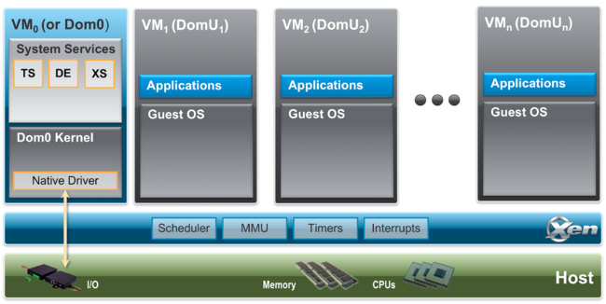
Case study: Amazon EC2
Clients:
Instances:
Xen hypervisor:
domain0 (dom0): routes packets and reports itself as a hop.

Slide 11
Step 1: map the internal cloud infrastructure
A challenge: Instance placement is not disclosed by Amazon but needed by the attacker
Map the EC2 service to understand where instances are placed
A hypothesis (Ristenpart et al. [CCS’09]) :
Different availability zones and instance types correspond to different internal IP address ranges (a private IP address indicates the physical location of a given instance)
Survey public servers on EC2

Slide 12
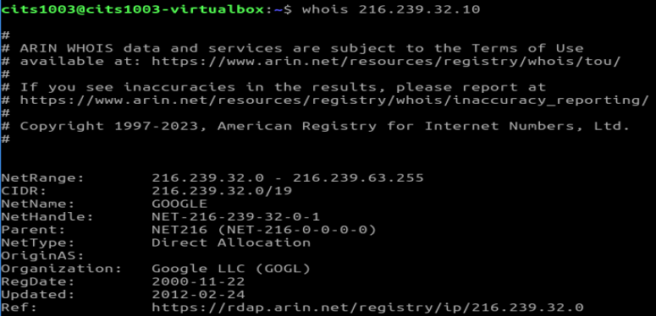
Survey public servers on EC2
Create a set of public EC2-based web services (Ristenpart et al. [CCS’09])
Use WHOIS to identify distinct public IP address prefixes associated with instances.

Slide 13
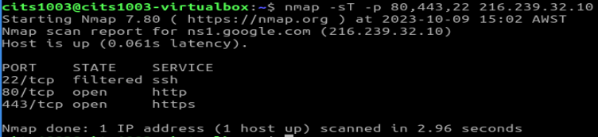
Survey public servers on EC2
Create a set of public EC2-based web services (Ristenpart et al. [CCS’09])
Use WHOIS to identify distinct public IP address prefixes associated with EC2
Use external networking probing to find responsive IPs
Tools used to probe ports (e.g., 80 and 443), e.g., nmap, hping and wget
nmap: performs TCP connect probes

Slide 14
Survey public servers on EC2
Create a set of public EC2-based web services (Ristenpart et al. [CCS’09])
Use WHOIS to identify distinct public IP address prefixes associated with EC2
Use external networking probing to find responsive Ips
Tools used to probe ports (80 and 443), e.g., nmap, hping and wget
hping: performs TCP traceroutes

Slide 15
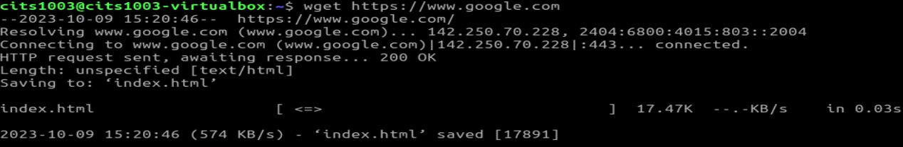
Survey public servers on EC2
Create a set of public EC2-based web services (Ristenpart et al. [CCS’09])
Use WHOIS to identify distinct public IP address prefixes associated with EC2
Use external networking probing to find responsive Ips
Tools used to probe ports (80 and 443), e.g., nmap, hping and wget
wget: retrieves web pages

Slide 16
Survey public servers on EC2
Create a set of public EC2-based web services (Ristenpart et al. [CCS’09])
Use WHOIS to identify distinct public IP address prefixes associated with EC2
Use external networking probing to find responsive IPs
Tools used to probe ports (80 and 443), e.g., nmap, hping and wget
Map all responsive public IPs to private IPs using the EC2’s internal DNS

Slide 17
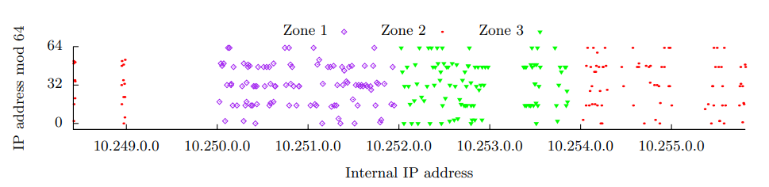
EC2 Instance placement properties
Ristenpart et al. [CCS’09]

Slide 18
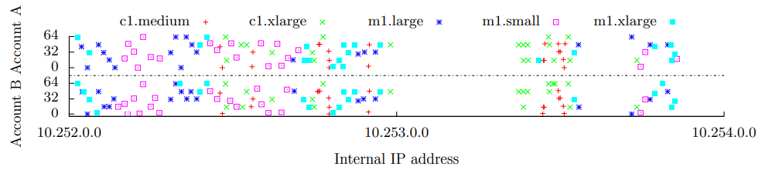
EC2 Instance placement properties
Ristenpart et al. [CCS’09]

Slide 19
Step 2: check if two instances are co-resident on the same physical machine
Use the set of created instances.
Check for co-residence (network-based): (Ristenpart et al. [CCS’09])
Match Dom0 public IP address,
Show small packet round-trip time, or
Exhibit numerically close internal IP address (e.g., within 7)

Slide 20
Step 3: launch a VM that is highly likely to be co-resident with the target VM
Brute-force placement
Temporal locality in placement
instances that are launched at the same time are more likely to be assigned to the same physical machine
Ristenpart et al. [CCS’09]

Slide 21
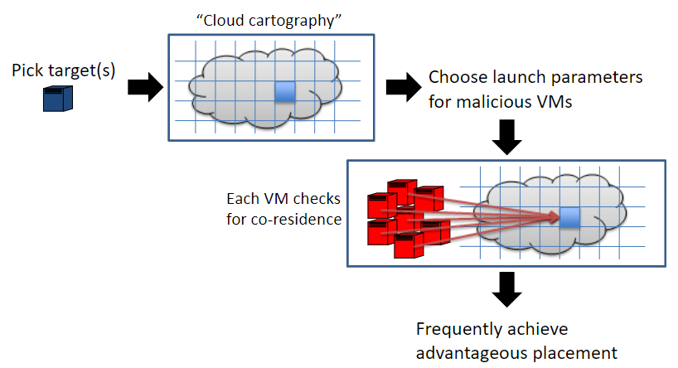
Steps 1-3: achieving co-residence with a target VM
Ristenpart et al. [CCS’09]

Slide 22
Mitigating co-residence attacks
Updating VM placement policy
Updating networking management
Deploying VPC

Slide 23
Updating VM placement policy
Larger pool of physical machines
More machines host the same type of instances.

Slide 24
Updating VM placement policy
Larger pool of physical machines
Reduced placement locality

Slide 25
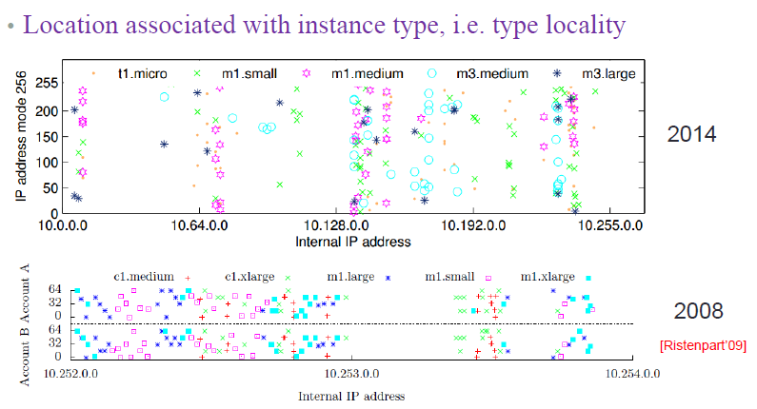
Updating VM placement policy
Larger pool of physical machines
Reduced placement locality
Reduced type locality
recent study
previous study

Slide 26
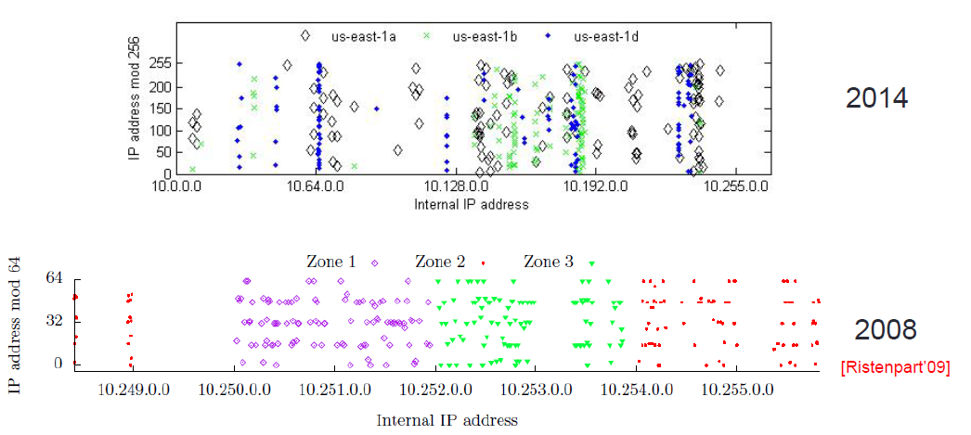
Updating VM placement policy
Larger pool of physical machines
Reduced placement locality
Reduced zone locality
recent study
previous study

Slide 27
Updating VM placement policy
Larger pool of physical machines
Reduced placement locality
More dynamic assignment of placing virtual machines
Public-private IP address mapping changes frequently
Different types of instances can be placed in same physical machine

Slide 28
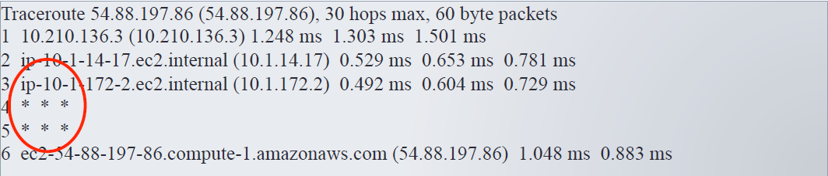
Updating networking management
Hide Domain0
Domain0 is the identifier of a physical machine
Domain0 is hidden in a network routing path
Hide information of specific hops in the routing path
Sensitive routers and switches do not appear in the trace-routing path

Slide 29
Deploying VPC
VPC is a service widely used in EC2 to enhance cloud security
Provides an isolated networking environment to host instances
Private IP address is invisible to outsiders

Slide 30
Is it possible to achieve co-residence in the presence of the countermeasures?
Yes!

Slide 31
Step 4: launch cross-VM attacks
hardware fault attacks:
e.g., rowhammer-induced accuracy depletion in deep-learning models
side channel attacks:
e.g., power consumption-based deep-learning model stealing

Slide 32
Rowhammer-induced accuracy depletion in deep-learning models

Slide 33
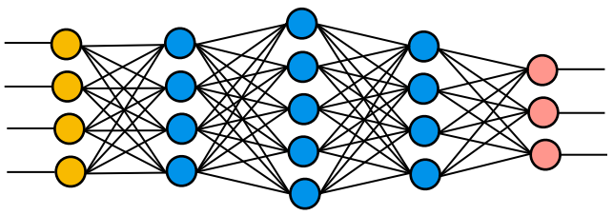

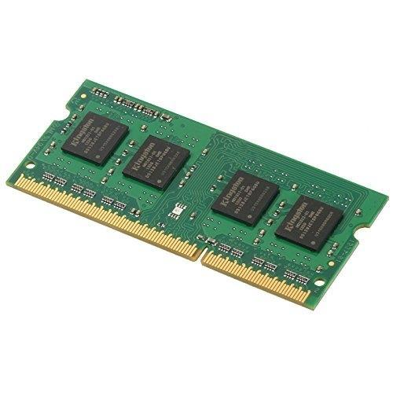
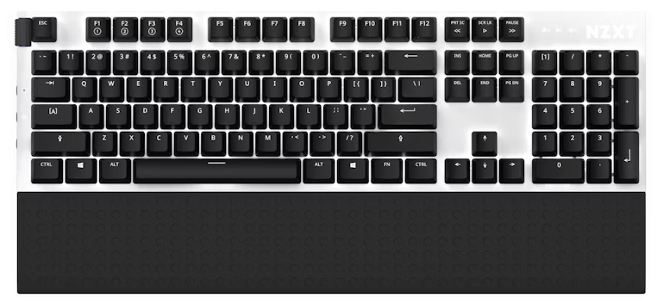
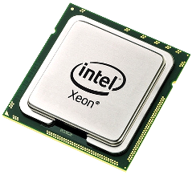
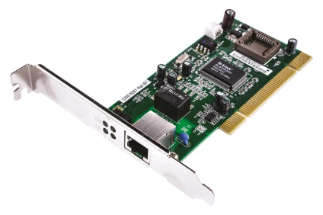
Malicious VM
Victim VM
VMM/hypervisor
SW
HW
DRAM memory is prone to rowhammer faults.

Slide 34
DNN key terms
Training: feed-forward and back-propagation
For given input data, it goes through from the input layer to the output layer (feed-forward). The resultant output is compared against ground truth via a loss function. To minimize the loss, the weights of the network are updated accordingly (back-propagation).
Inference: a well-trained model is used to infer real-world unseen data

Slide 35
DNN key terms
Training: feed-forward and back-propagation
Inference: a well-trained model is used to infer real-world unseen data
DNN architecture: the whole set of processing layers.
Hyperparameters: decides a DNN architecture.
layers and layer-wise hyperparameters
layers: the number of layers and the type of each layer, e.g., convolutional layer, pooling layer, and fully-connected layer.
layer-wise hyperparameters, e.g., the neuron number for a fully-connected layer.
Parameters: configuration variables (i.e., weights and bias) of a specific model and their values are decided via training.

Slide 36
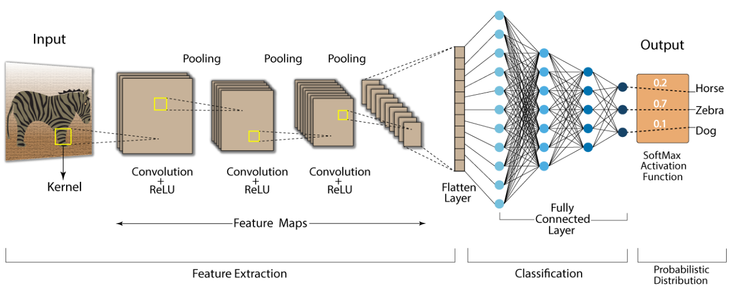
An example: CNN

Slide 37
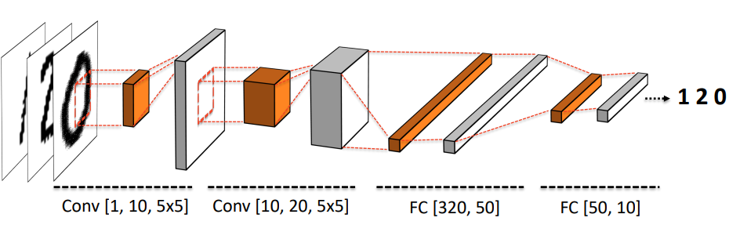
How DNN Computes
Prediction accuracy: 98.53%
https://www.usenix.org/conference/usenixsecurity19/presentation/hong

Slide 38
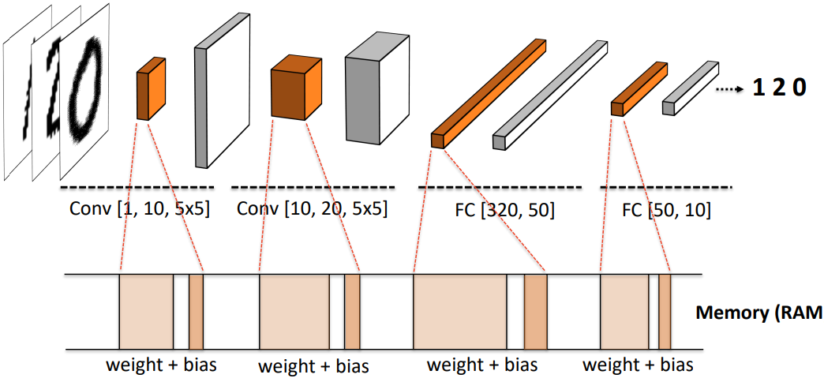
DNN parameters are stored in memory
https://www.usenix.org/conference/usenixsecurity19/presentation/hong

Slide 39
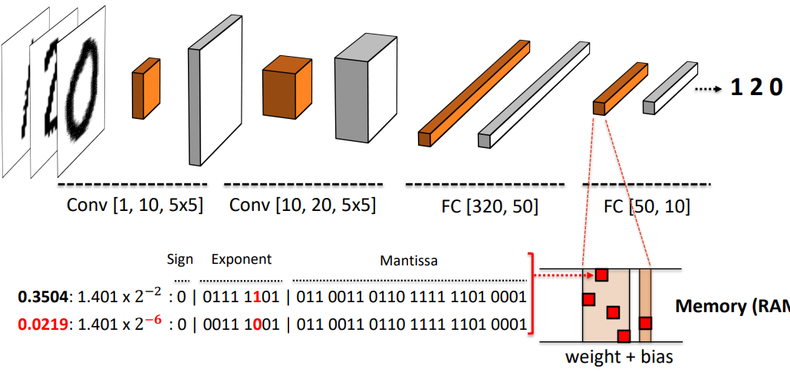
Faulting unimportant parameters
Prediction accuracy: 93.53% (5% drop)
https://www.usenix.org/conference/usenixsecurity19/presentation/hong

Slide 40
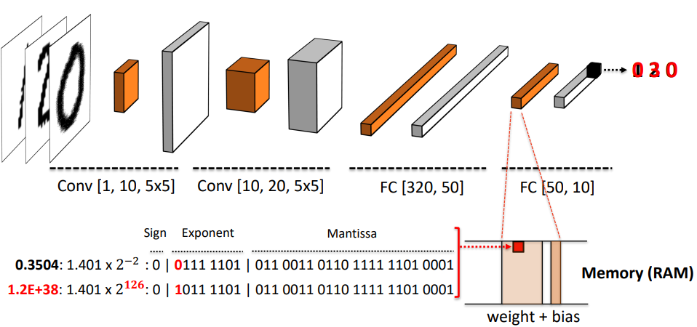
Faulting important parameters
Accuracy depletion
0 3 0
Prediction accuracy: 57.53% (41% drop)
https://www.usenix.org/conference/usenixsecurity19/presentation/hong

Slide 41

What is Rowhammer ?
Frequently accessing
Rowhammer:
DRAM rows

Slide 42
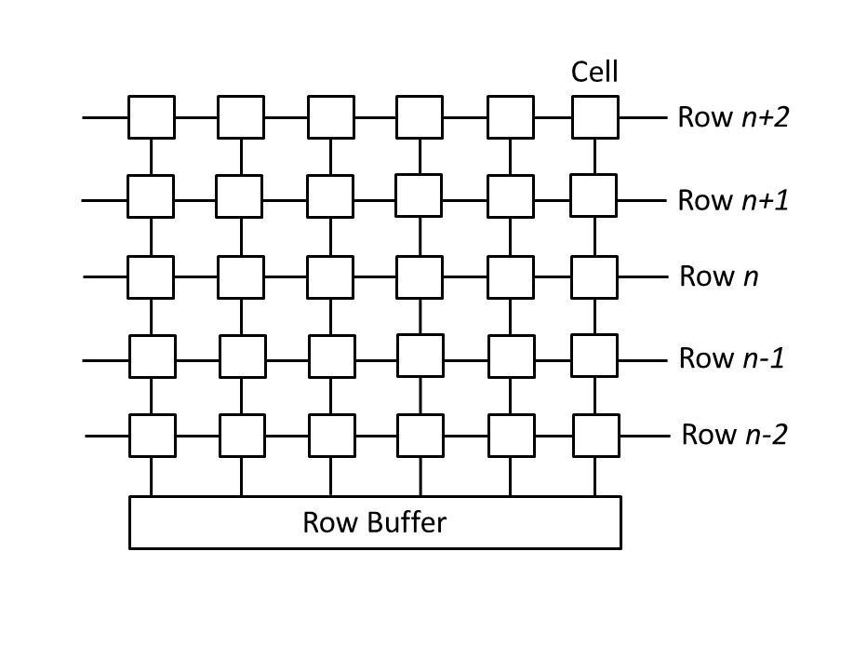
A memory access opens a DRAM bank
A bank has rows of cells
A cell is either charged or discharged to store bit 0 or 1
Row buffer facilitates memory access
Alternating row access clears row buffer

Slide 43
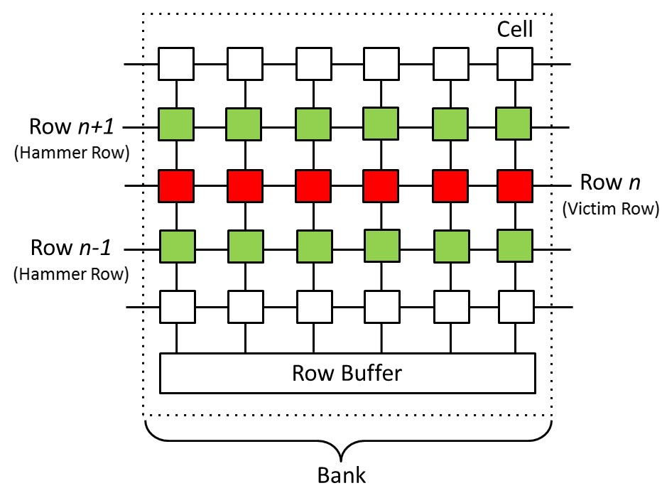
Rowhammer: a DRAM fault
Kim et al. (ISCA’14)
frequently opening rows n+1 & n-1 causes charge leakage (bit flips) in row n

Slide 44
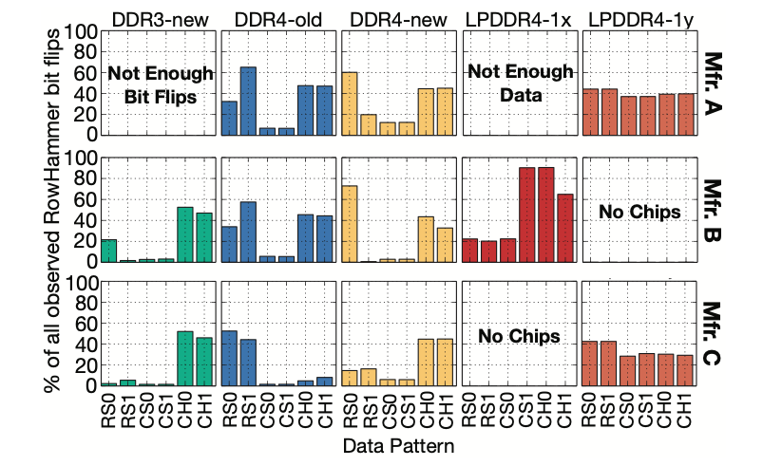
Modern DRAM is prone to rowhammer bit flips
Kim et al. (ISCA’20) have induced rowhammer bit flips on 1580 DRAM chips from 300 DRAM modules and from the three major DRAM manufacturers.

Slide 45
Rowhammer code
1 loop:
2 mov (X), %eax
3 mov (Y), %ebx
4 clflush (X)
5 clflush (Y)
6 jmp loop
What is purpose of lines 2-3?
Clear row buffer (e.g., alternate access)

Slide 46
Rowhammer code
1 loop:
2 mov (X), %eax
3 mov (Y), %ebx
4 clflush (X)
5 clflush (Y)
6 jmp loop
What is the purpose of lines 4-5?
flush CPU cache (e.g., clflush)

Slide 47
Hammer pattern
1 loop:
2 mov (X), %eax
3 mov (Y), %ebx
4 clflush (X)
5 clflush (Y)
6 jmp loop
Double-sided hammer
X and Y are adjacent to the target row
Single-sided hammer
Either X or Y is adjacent to the target row
Common
X and Y must be in the same bank to clear row buffer

Slide 48
Hammer pattern
1 loop:
2 mov (X), %eax
3 mov (Y), %ebx
4 clflush (X)
5 clflush (Y)
6 jmp loop
Double-sided hammer
X and Y are adjacent to the target row
Single-sided hammer
Either X or Y is adjacent to the target row
Common
X and Y must be in the same bank to clear row buffer
Requirements
Mapping between a virtual address and its physical address
Mapping between a physical address and its DRAM location

Slide 49
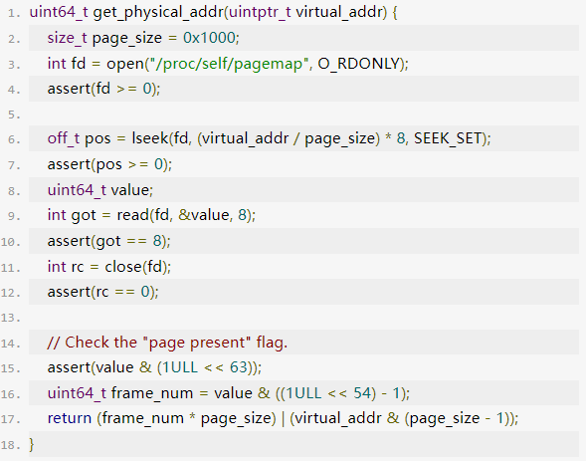
Mapping between a virtual address and its physical address

Slide 50
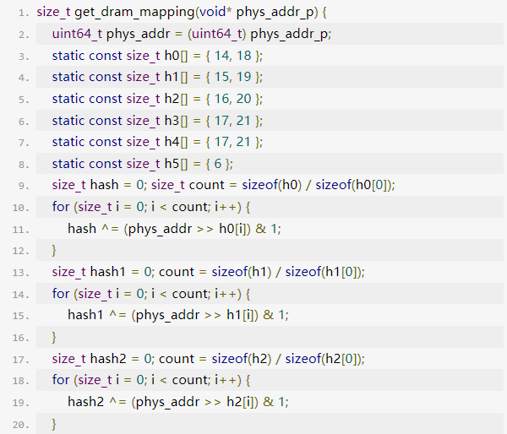
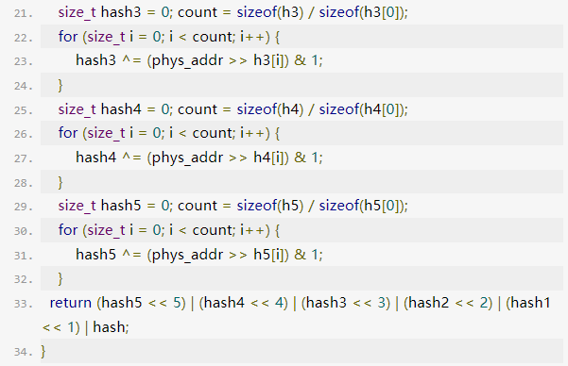
Mapping between a physical address and its DRAM location
1. bank is decided by certain bits of a physical address.

Slide 51
Mapping between a physical address and its DRAM location
1. bank is decided by certain bits of a physical address.
2. Row index is decided by bits 18-32 of a physical address.

Slide 52
Power consumption-based deep-learning model stealing

Slide 53
Malicious VM
Victim VM
VMM/hypervisor
Intel RAPL framework
SW
HW
CPU and DRAM power consumption are available to VMs via Intel RAPL (Running Average Power Limit) framework.

Slide 54
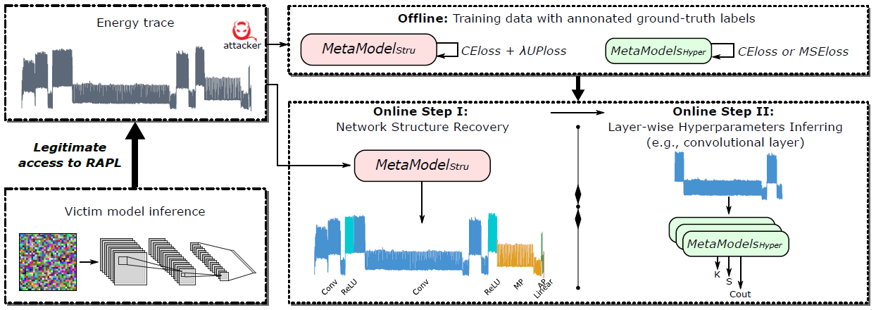
The flow of model stealing
Zhang et al. (S&P’24)

Slide 55
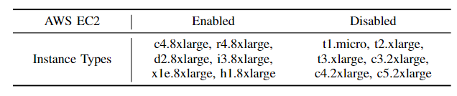
Based on our observation, some (not all) EC2 instances have provided access to RAPL

Slide 56
Malicious Container
Victim Container
Docker engine
Host OS
SW
Intel RAPL framework
HW
A proof-of-concept (PoC) attack has been demonstrated in a recent docker environment, i.e., version 20.10.1
Zhang et al. (S&P’24)

Slide 57
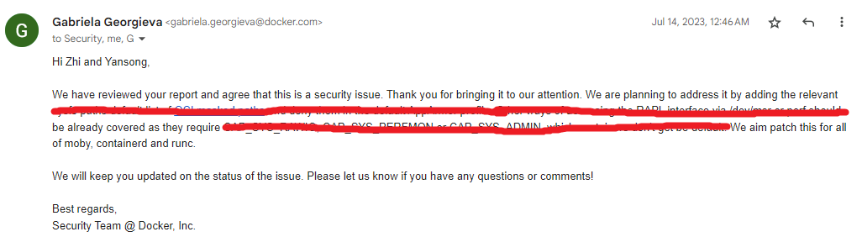
Docker container
CVE-2023-5453 has been reserved tentatively.
What is CVE?

Slide 58
Docker container
CVE-2023-5453 has been reserved tentatively.
What is CVE?
short for Common Vulnerabilities and Exposures. The CVE list is a National Vulnerability Database (NVD) maintained by the U.S. government.

